Slide 1

Data Structure
1

Slide 2
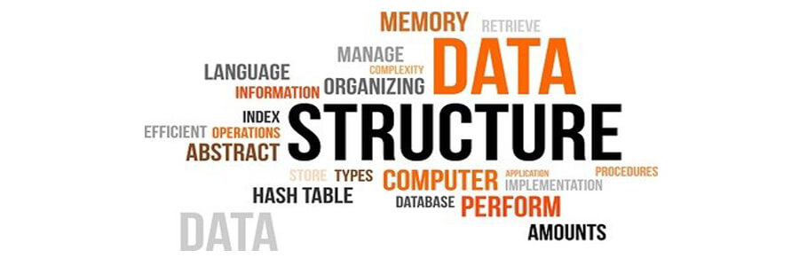
Data Structure
A data structure is a functional configuration of organizing and storing data.
It generally contains two parts:
The ledger.
The states.

Slide 3
Ledger
A ledger is a chronological storage of facts or records order.
Facts are like rows in a table.
All peers to a shared fact stores identical records.
Quorum nodes use distributed ledger mechanism.
Each peer only sees a subset of facts on the ledger and no peer is aware of the ledger in its entirety.
There is no single data storage. Each node maintains a separate database.

Slide 4

State
State is an immutable object that represents facts which are known by one or more nodes at a specific point of time. Data is not modified directly.
States are never altered, they are either unconsumed (unspent) or consumed (spent).
States contain reference to contracts that govern the evolution of state.
States maintain their own database which is divided into two:
Public State Database
Private State Database

Slide 5
THANK YOU!

